Slide 1
AI – Powered Candidate Assessment System
21K-3451 Ashesh Kumar
21K-4589 Abdul Wasay
21K-4926 Fahad Ahmed
Supervisor: Ms. Nida Munawar

Slide 2
Introduction
Purpose:
To develop an innovative recruitment system that leverages AI to streamline the process of CV parsing, job matching, and candidate evaluation.
Core Focus:
Initial development focuses on integrating AI for CV parsing, automating job matching, and efficiently evaluating candidates.
Scope of FYP-1:
Focus on developing the core components:
detailed schema design for database management
initial development of the frontend interface
integration of AI for CV parsing.

Slide 3
Related Work
Current Technologies: Overview of how AI is currently being used in recruitment.
Comparison: Contrast with existing platforms like LinkedIn and automated screening tools.
Identified Needs: Specific gaps in customization and integration capabilities that this project aims to address.

Slide 4






Methodology
Database Management: Implementation of MongoDB for its flexibility and scalability.
Frontend Development: Use of React for dynamic user interfaces.
Backend Processing: Integration of Node.js and Express.js for robust backend services.
Version Control: Use of Github for version control, pull request and CI/CD integration.
PlantUML, Eraser.io, Figma: For interactive diagrams and frontend mockups.
AI Integration: Employment of SBERT and GPT for processing and analyzing data.

Slide 5
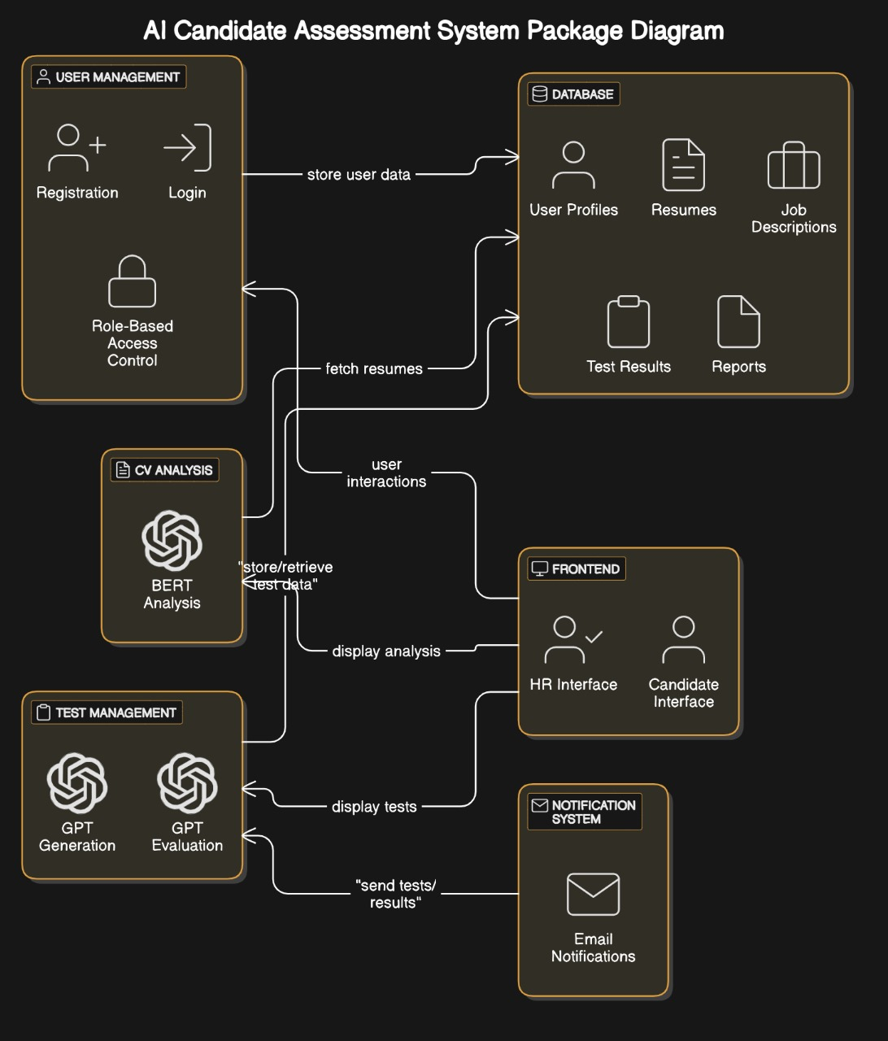
System Diagram

Slide 6
FYP-1 RoadMap
Month 1:
Conduct requirement gathering sessions with team members and supervisors.
Research existing AI-driven recruitment systems for insights.
Draft the initial SRS document.
Month 2:
Create system architecture based on requirements defined in the SRS.
Develop the SDS, detailing the technical specifications, system architecture, and data flows.
Start designing the database schema.
Month 3:
Create detailed frontend mockups for key user interfaces.
Finalize the database schema based on the SDS.
Continue refining the SDS based on evolving project insights.
Month 4:
Research AI technologies (SBERT, GPT) for CV parsing and classification.
Develop a prototype for CV classification integrating insights from research.
Test the CV classification prototype and refine based on feedback.

Slide 7
FYP-2 Roadmap
Month 5:
Develop API endpoints to connect frontend and database.
Integrate React components with Node.js backend services.
Conduct integration testing to ensure seamless functionality.
Month 6:
Integrate and configure GPT for automated test generation.
Optimize SBERT integration for enhanced CV parsing accuracy.
Perform rigorous testing to validate AI functionalities.
Month 7:
Deploy the system in a controlled environment for user testing.
Collect and analyze user feedback for system improvements.
Refine user interfaces and backend processes based on feedback.
Month 8:
Prepare the production environment and deploy the system.
Develop comprehensive user manuals and system documentation.
Review all project phases and prepare the final project report.

Slide 8
Benefits of System
Increased Efficiency: Automates CV parsing and candidate evaluations, reducing HR workload.
Accuracy: Uses AI (SBERT, GPT) to enhance job matching and minimize errors.
Scalability: Easily handles growing data volumes and user requests.
Cost Savings: Decreases operational costs by reducing manual efforts.
Improved Candidate Experience: Streamlines the application process, increasing satisfaction.
Data-Driven Insights: Facilitates informed HR decisions through detailed analytics.
Customization: Adapts to specific organizational needs.
Regulatory Compliance: Ensures adherence to employment laws and regulations.

Slide 9
Software Requirement Specification Snippets

Slide 10
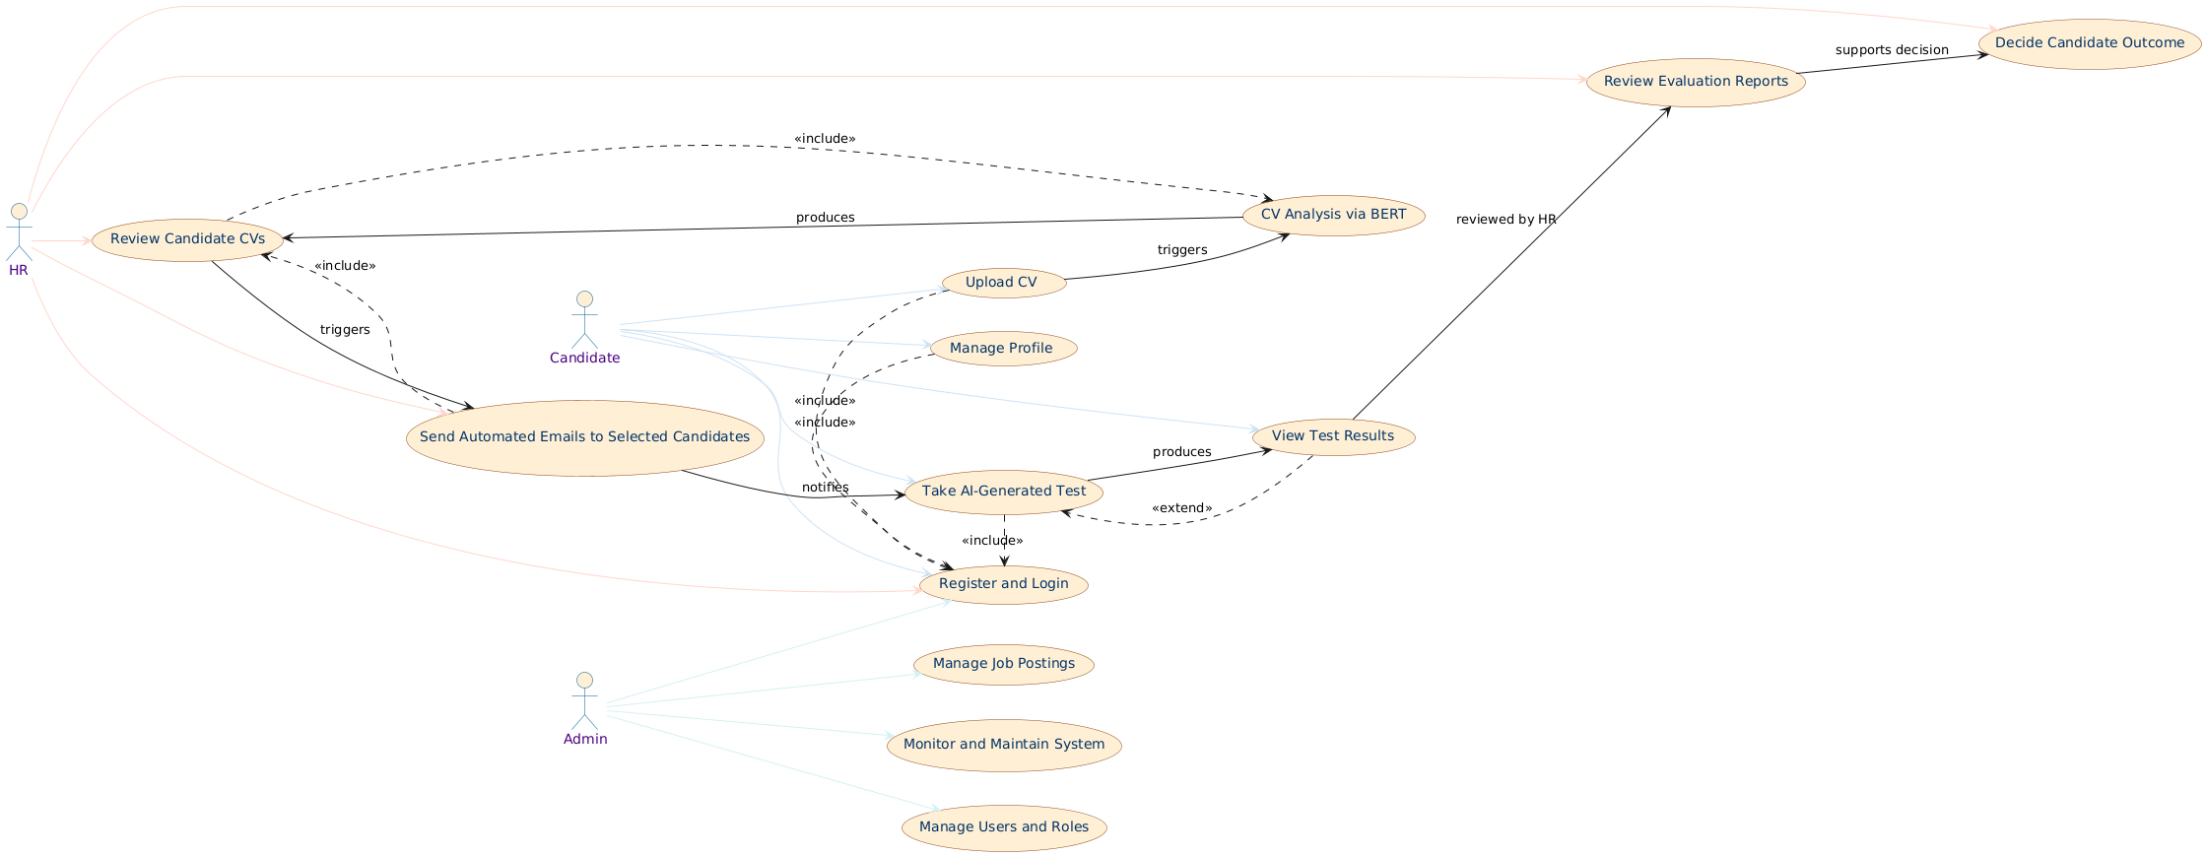
Use case Diagram for Product Setup

Slide 11
Description
Actor:
HR: Responsible for managing candidate applications, reviewing CVs, and making hiring decisions.
Candidate: Applies for jobs, uploads CVs, and takes AI-generated tests.
Admin: Oversees system operations, job postings, and user management.
Preconditions:
The system must be fully configured, including AI models (SBERT and GPT), database schema, and notification services.
Candidates, HR, and Admin users must have active accounts with appropriate permissions for their respective roles.
Valid job postings must exist in the system for candidates to apply and HR to evaluate applications.
Basic Flow:
Candidate: Registers, uploads CV, and takes AI-generated tests based on skills.
HR: Reviews CVs, test results, and makes selection decisions.
Admin: Manages job postings, users, and system configurations.
System: Automates notifications, CV parsing, and test generation for efficient recruitment.
Postconditions: Candidates are notified, HR decisions are recorded, and system data is updated for future processes.

Slide 12
Software Design Specification Snippets

Slide 13
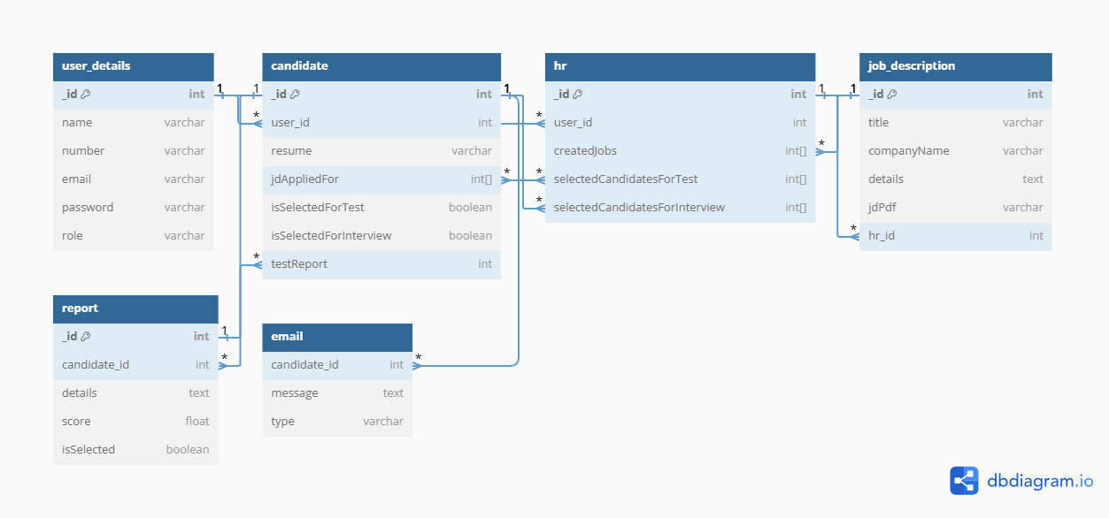
Entity Relationship Diagram

Slide 14
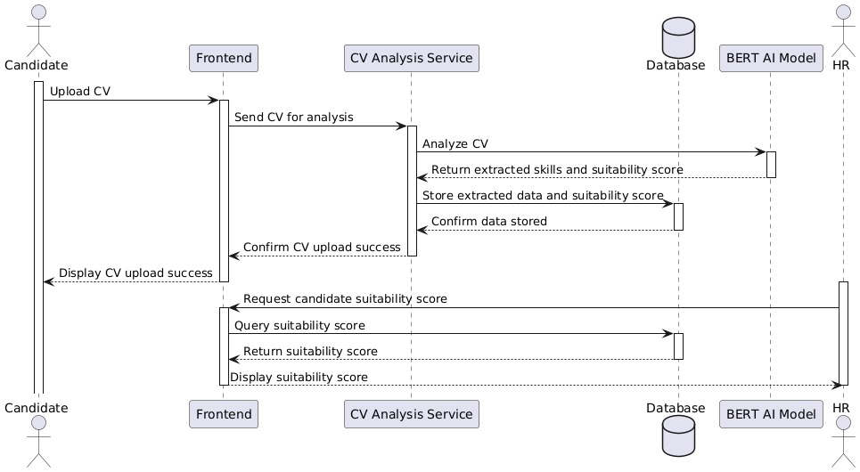
Sequence Diagram for CV upload and analysis

Slide 15
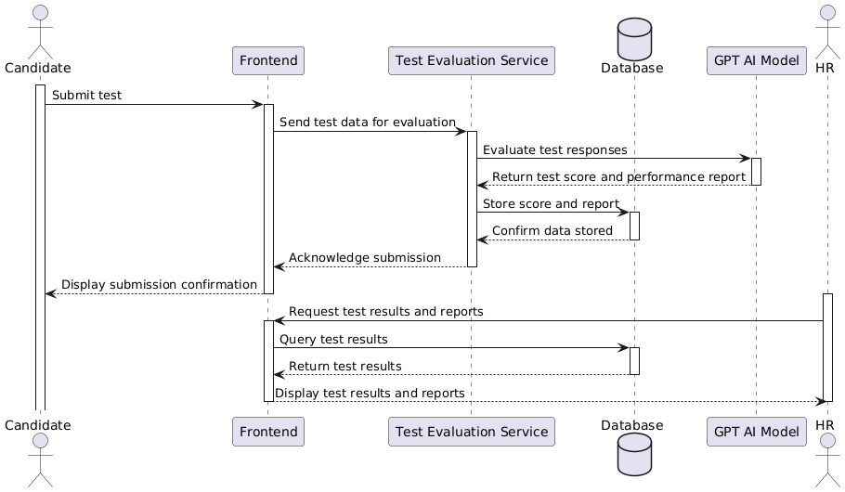
Sequence Diagram for Test submission and evaluation

Slide 16
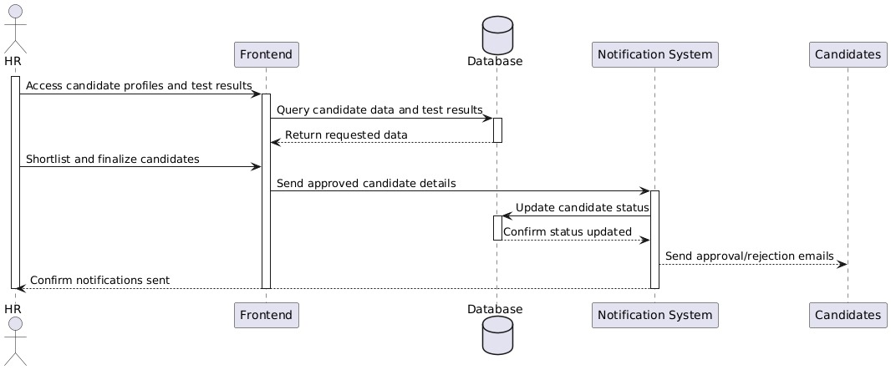
Sequence Diagram for Final candidate selection

Slide 17
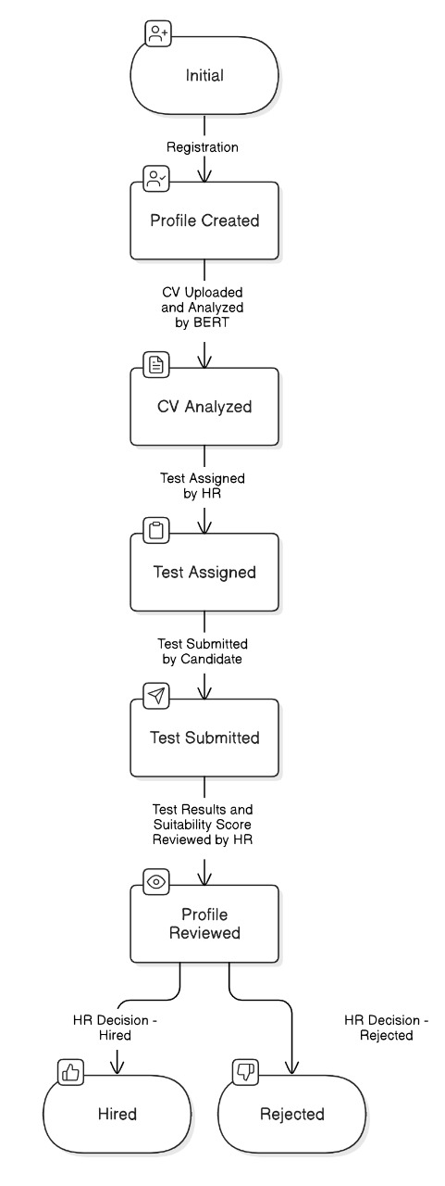
State Diagram for Candidate Profile

Slide 18
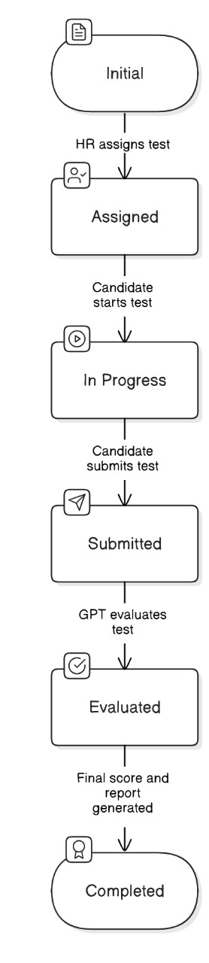
State Diagram for Test

Slide 19
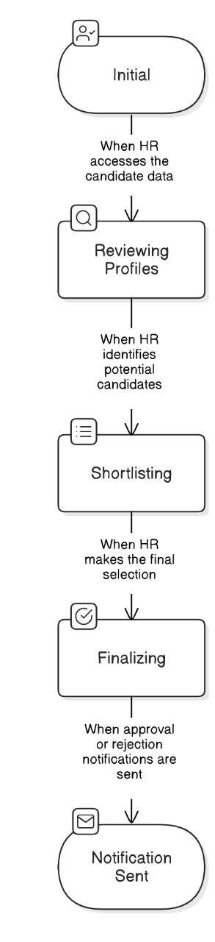
State Diagram for HR Decision

Slide 20
Coding Snippets

Slide 21
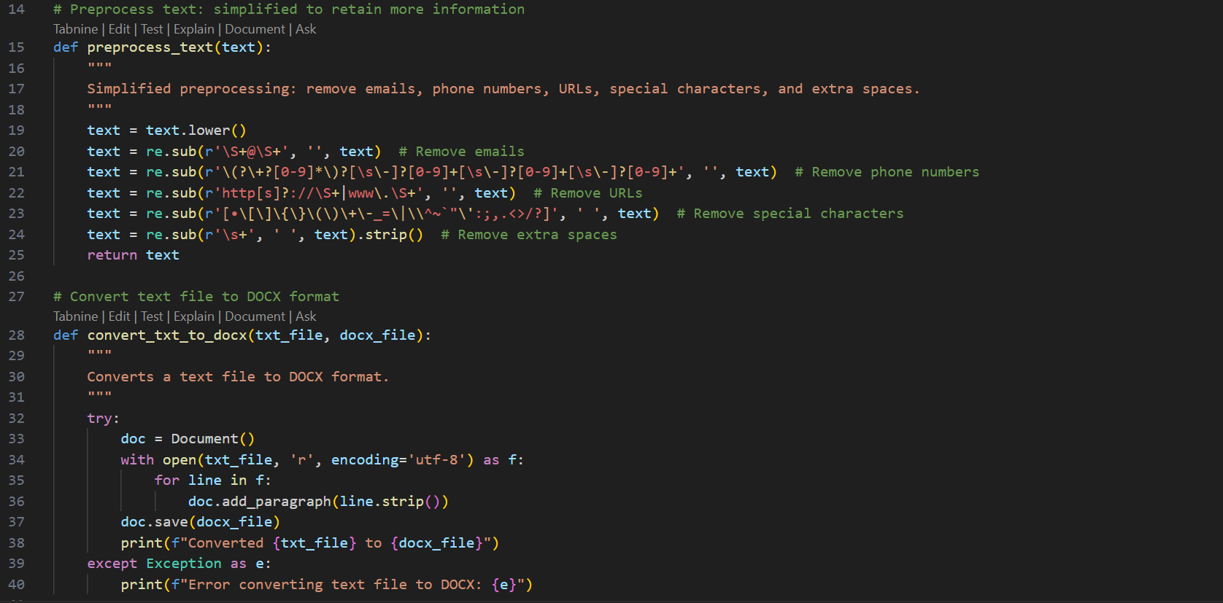

Slide 22
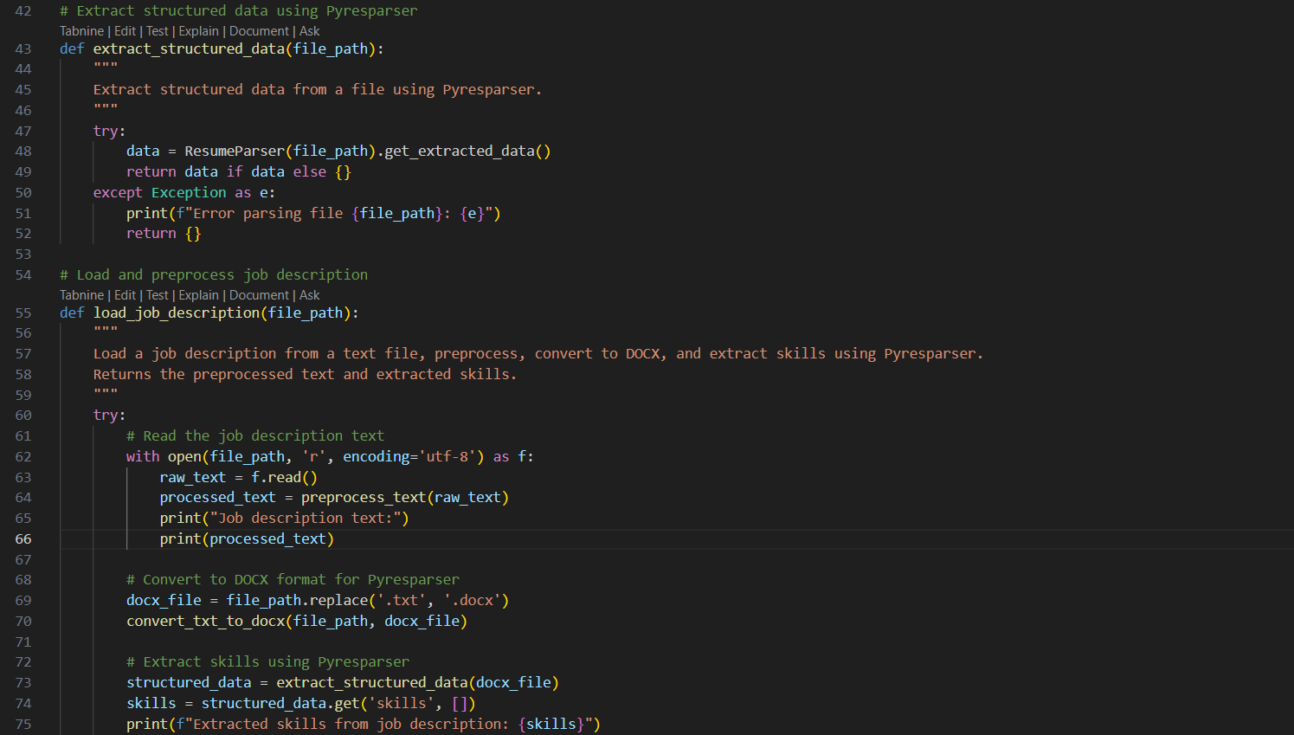

Slide 23
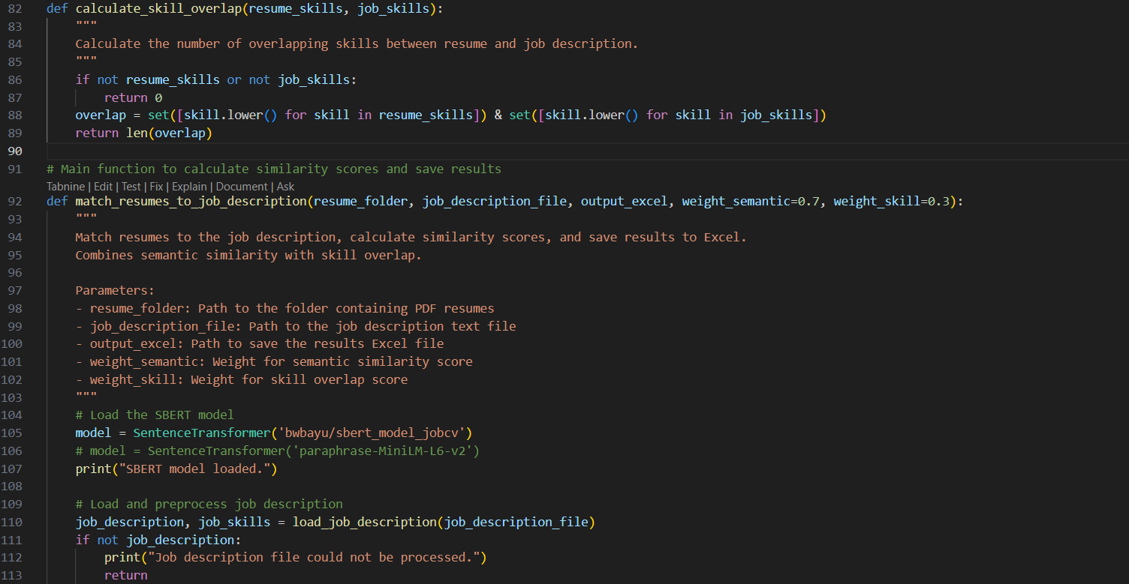

Slide 24
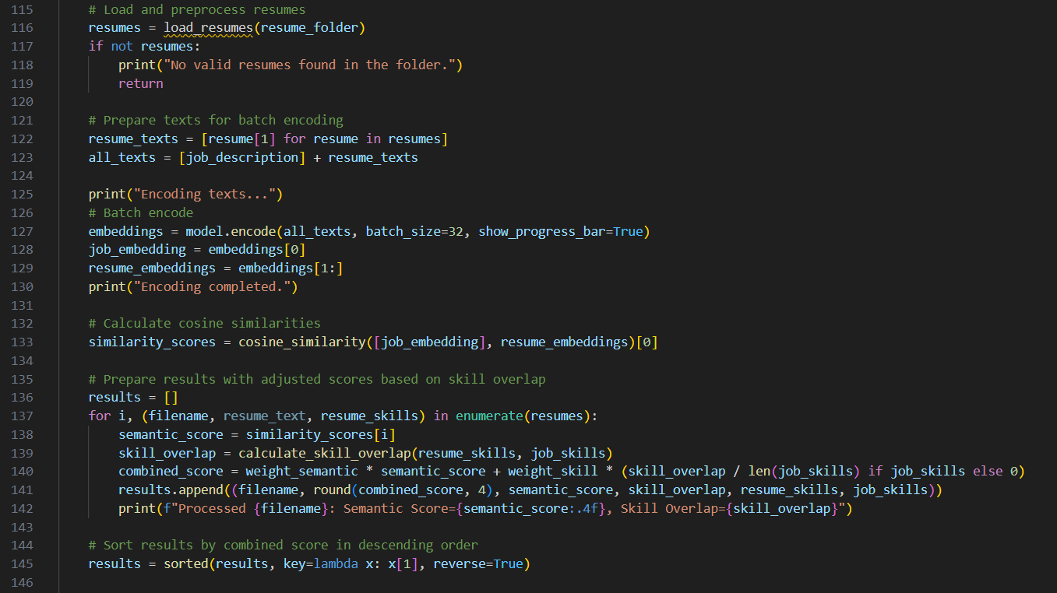

Slide 25
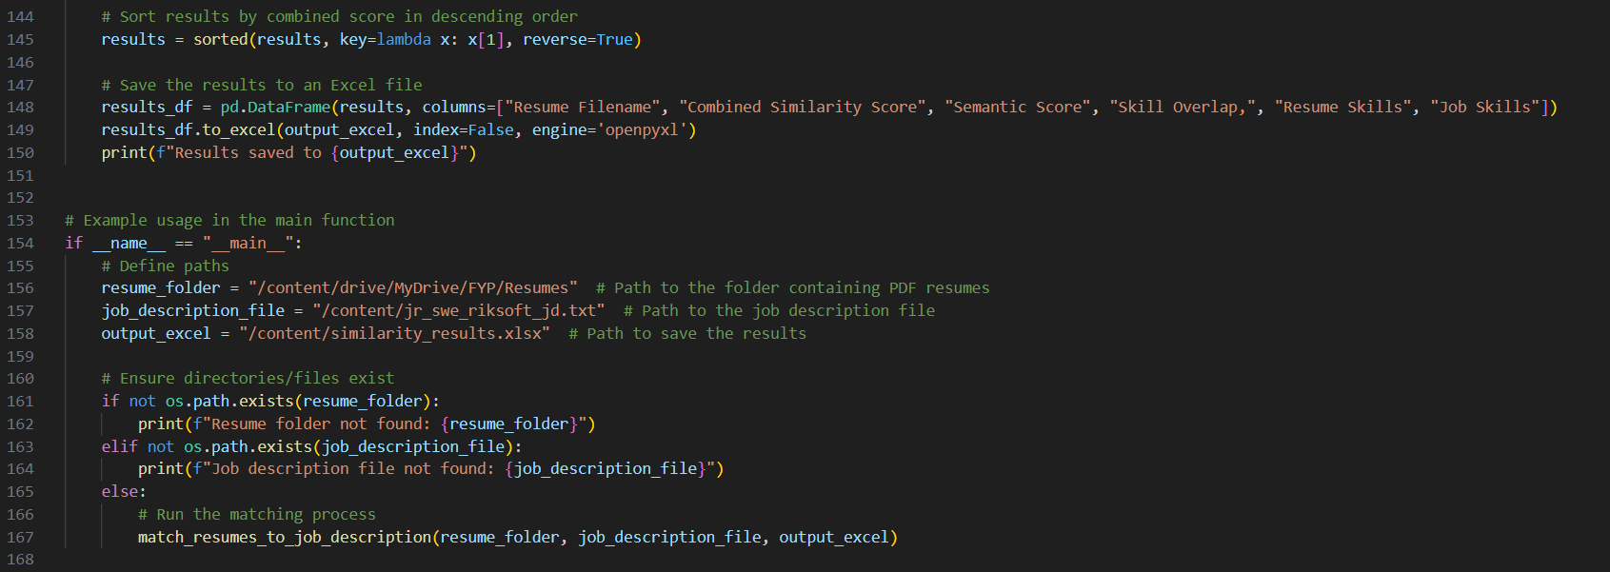

Slide 26
System Screenshots

Slide 27
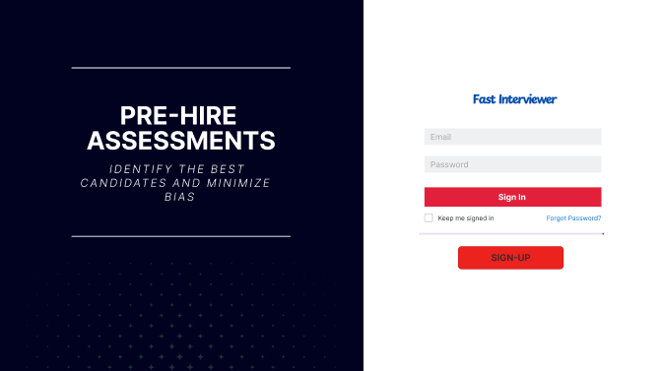

Slide 28
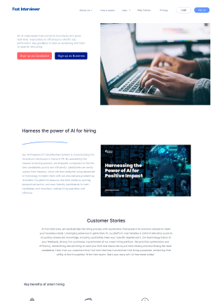

Slide 29
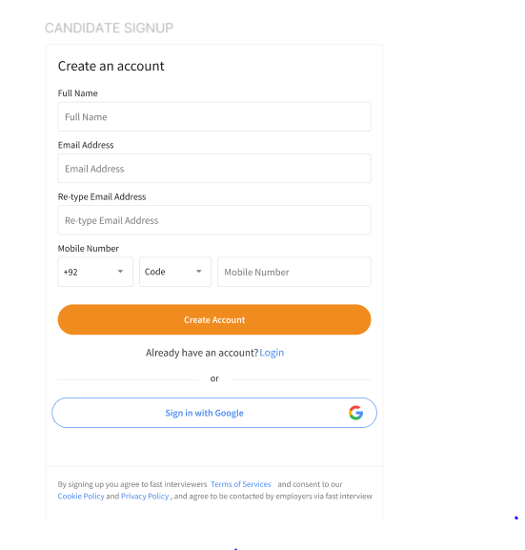
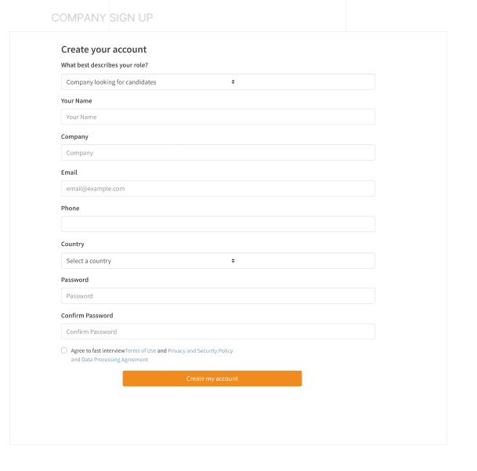

Slide 30
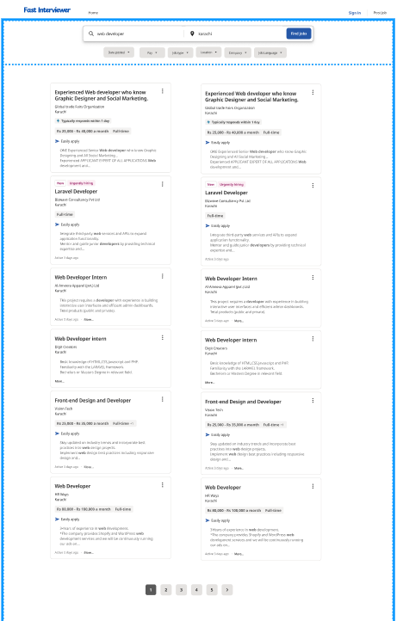

Slide 31
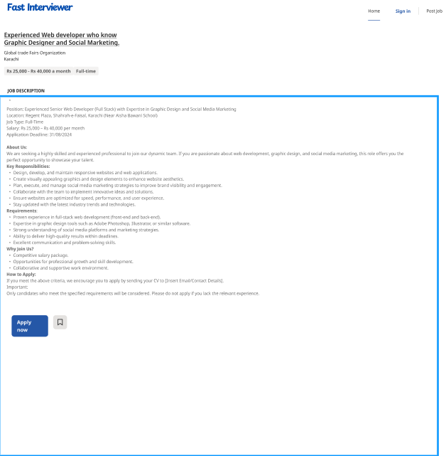

Slide 32
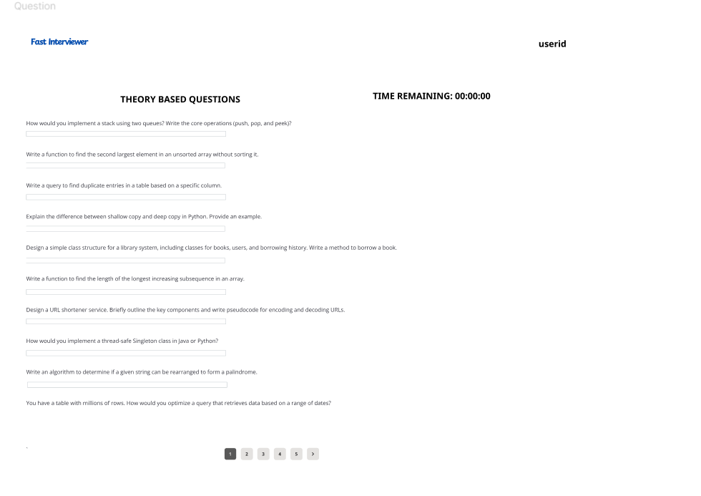

Slide 33
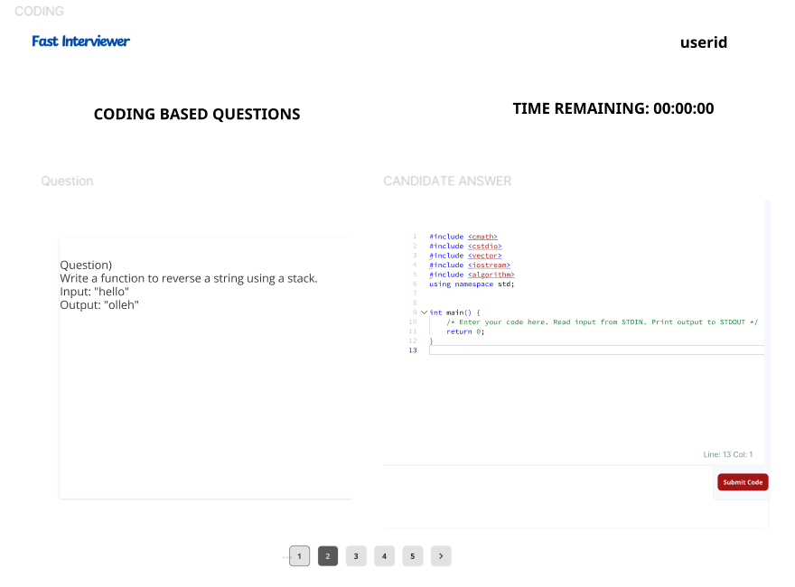

Slide 34
Thankyou

